Slide 1
Single-Step Latent Diffusion for Underwater Image Restoration
Presented by
M11407509 簡志融 M11407517 黃志傑
M11407W07 汪上安 M11407W03 鄭慶德

Slide 2
Outline
Background & Motivation
Underwater degradation, limitations of prior methods
Method: SLURPP Framework
Physics model, architecture, single-step latent diffusion
Experiments & Results
Quantitative benchmarks, qualitative restoration, robustness
Conclusion & Future Work
Key findings, next research directions

Slide 3
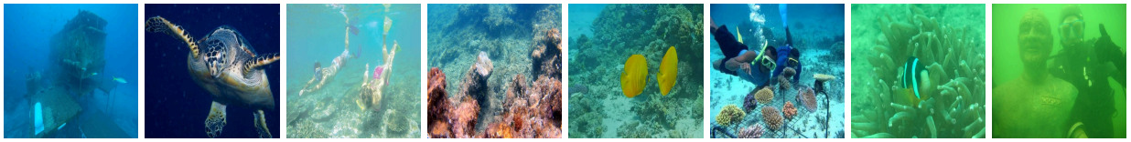
Why Underwater Image Restoration is Critical
Underwater images suffer from severe degradation effects hinder human visual perception and reduce computer vision accuracy in underwater environments.
Image restoration is crucial for applications such as marine ecology, underwater construction, archaeology, and AUV navigation.

Slide 4
Limitations of Prior Restoration Methods
Traditional Methods: Struggling with generalization across diverse underwater scenes.
Image Enhancement Methods: Potentially producing physically implausible results.
The Speed Issue: Prior diffusion methods require iterative denoising.
Existing Diffusion-Based Methods: Effective for simple scenes.
Poor Datasets: Lack ground truth clean images.

Slide 5
Harnessing Pretrained Knowledge for Restoration
SLURPP repurposes pretrained, large-scale latent diffusion models (LDMs).
Priors Used:
Target clear images align well with the natural scene content distribution learned by LDMs.
Water effects are highly correlated with scene depth.
Implementation: The network injects distinct diffusion priors tailored for their specific tasks.

Slide 6
SLURPP: Single-Step Latent Diffusion Framework
SLURPP overcomes limitations by combining a novel network architecture with a physically accurate data generation pipeline.
Key Advantages:
Efficiency: Fast single-step inference in the compact latent space.
Speed: Over 200× faster than previous diffusion methods.
Fidelity: ∼3dB improvement in PSNR on synthetic benchmarks.
Physical Grounding: Explicitly models and accounts for light attenuation.

Slide 7
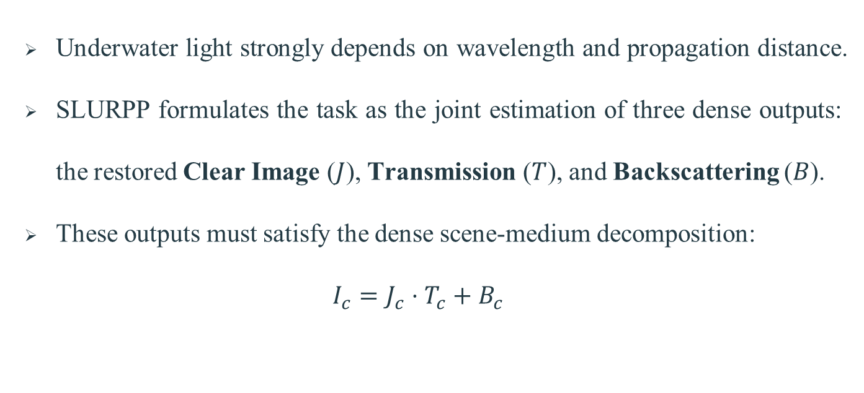
Problem : Dense Scene-Medium Decomposition

Slide 8
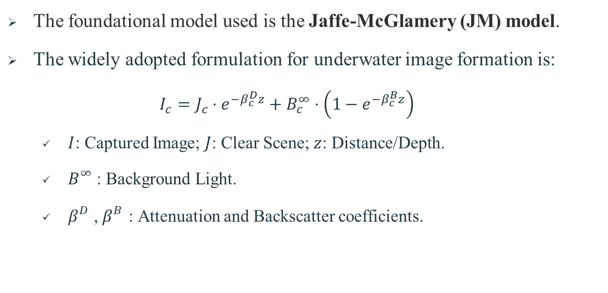
Physics Foundation: The Image Formation Model

Slide 9
Data Synthesis Pipeline Details (Physics-Grounded)
Component 1: Depth Estimation (z):
Uses Depth Pro to estimate accurate metric monocular depth.
This provides reliable per-pixel depth maps from large-scale image collections.
Component 2: Attenuation Coefficient (β):
Ensures consistency with real-world aquatic environments by randomly sampling from 10 Jearlov's water types.
The sampled coefficients guide the RGB intensities of β based on real optical measurements.

Slide 10
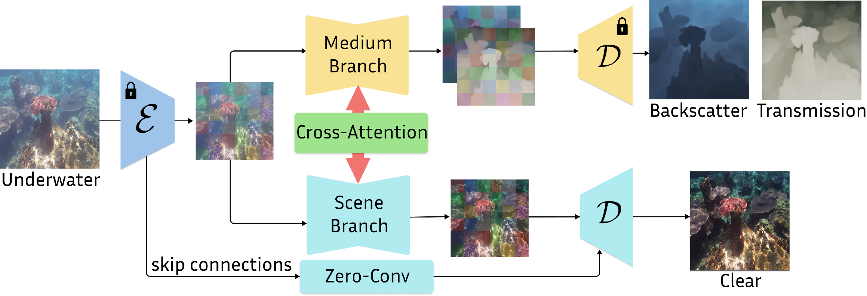
SLURPP Architecture: Dual-Branch UNet

Slide 11
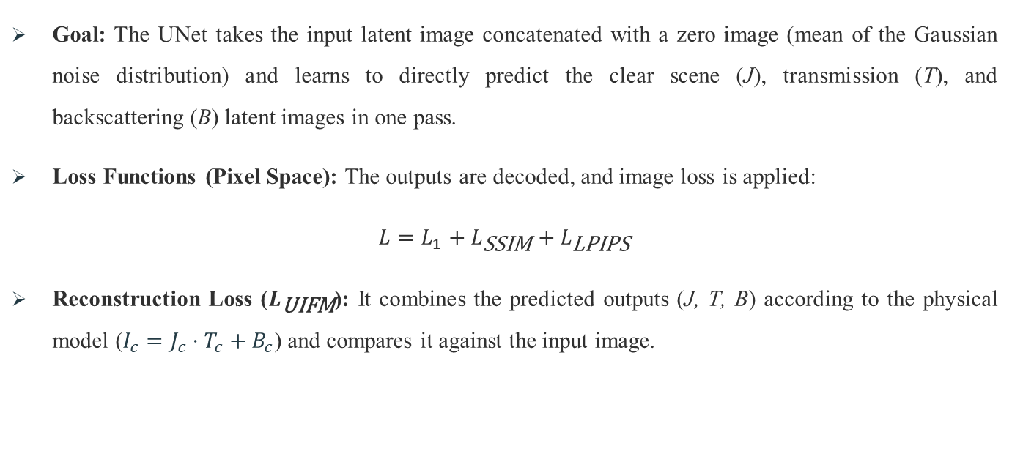
Single-Step Fine-Tuning

Slide 12
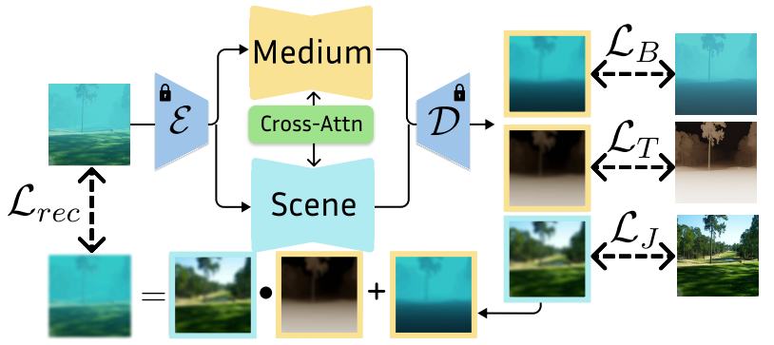
Single-Step Fine-Tuning

Slide 13
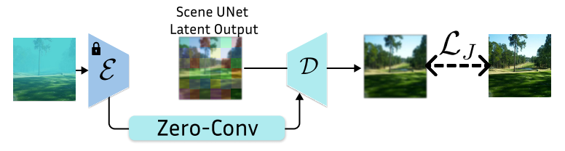
Detail Enhancement

Slide 14
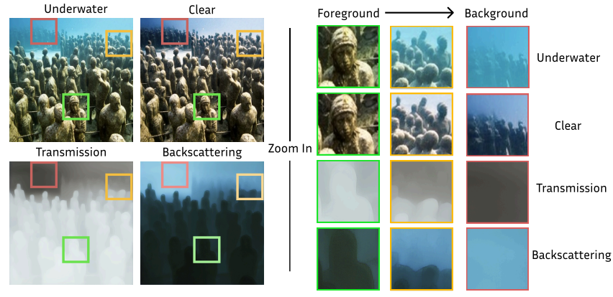
Inference

Slide 15
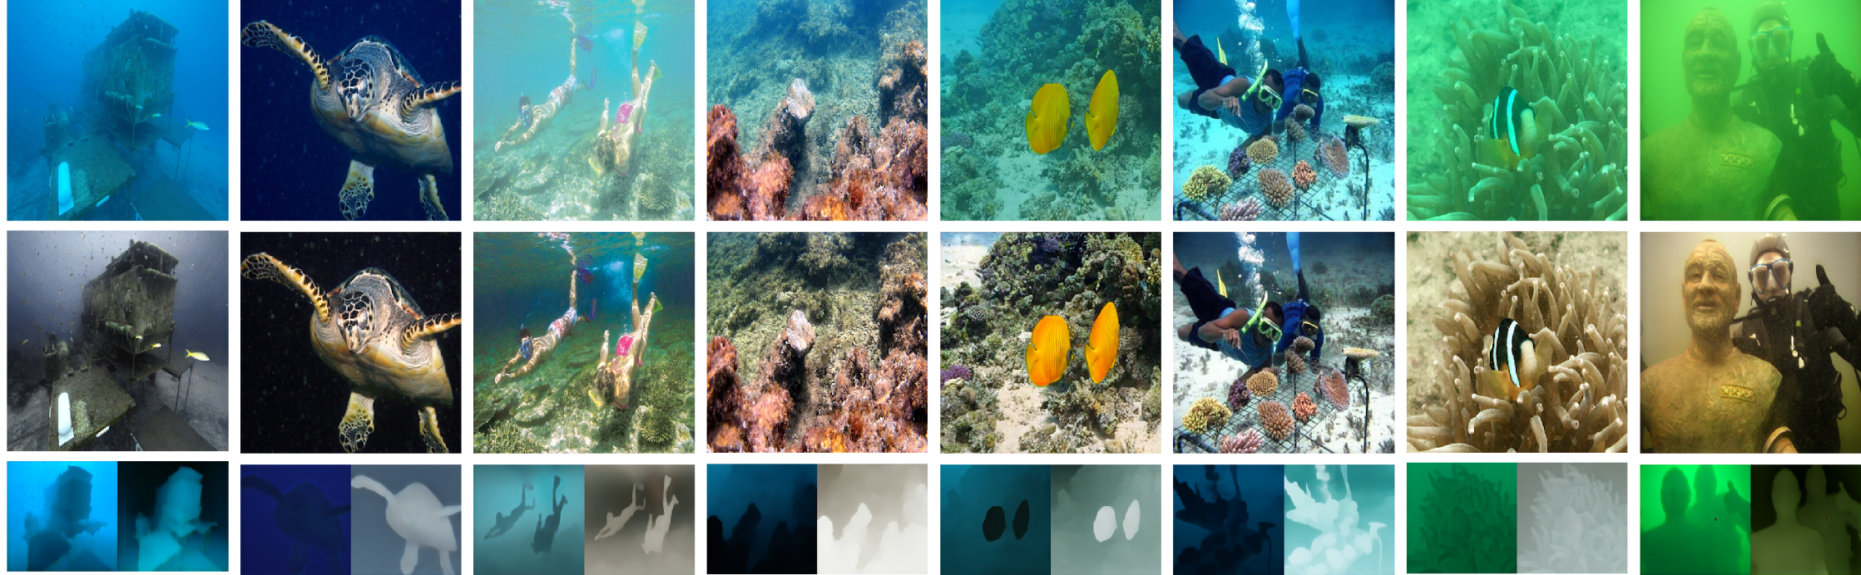
Inference

Slide 16
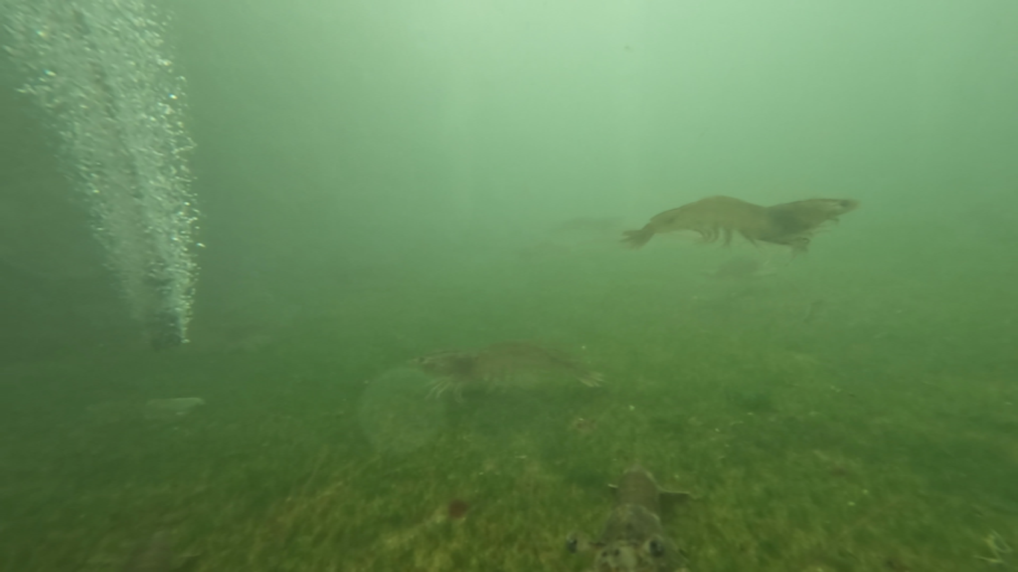
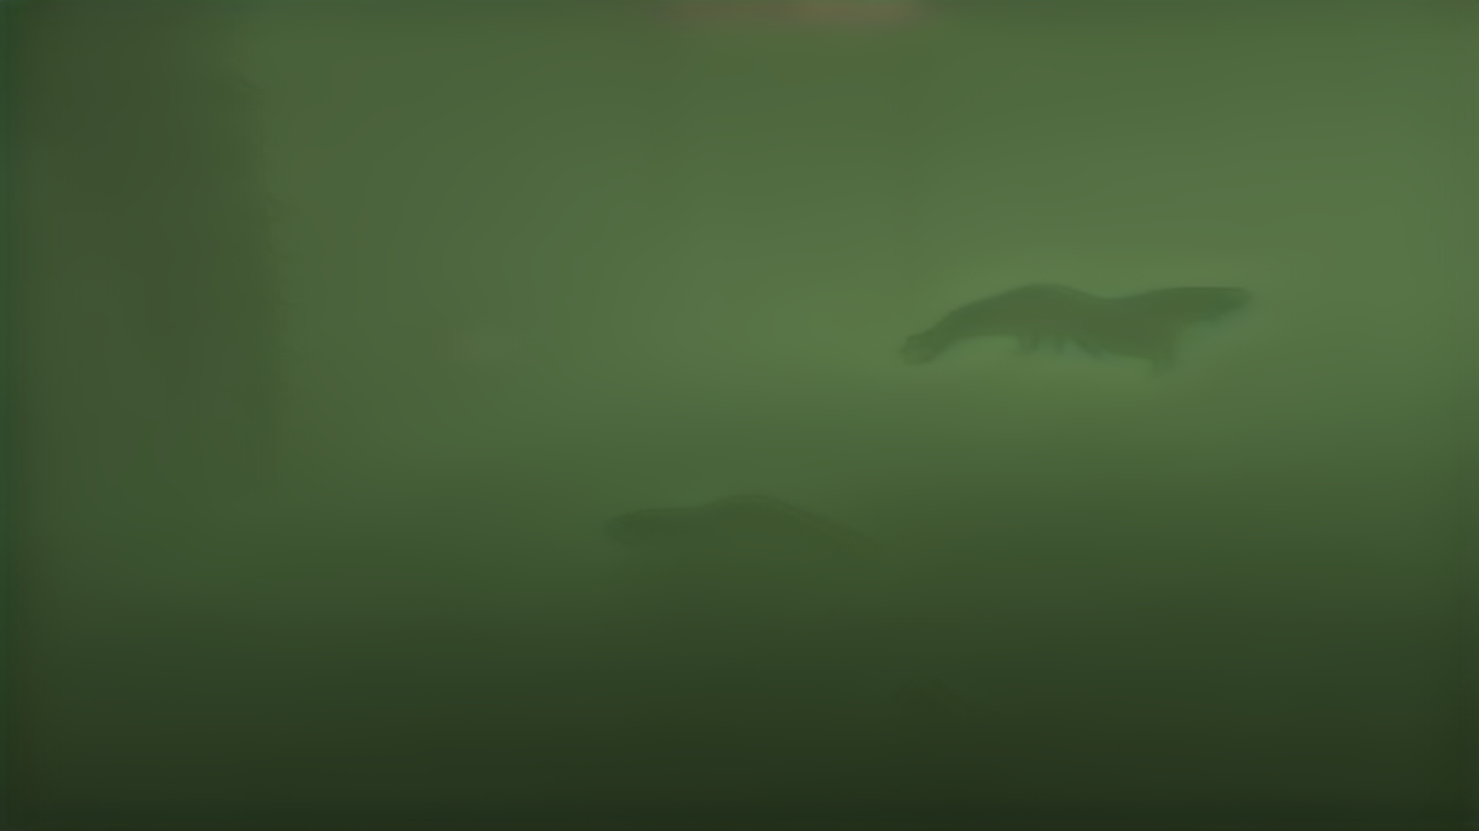

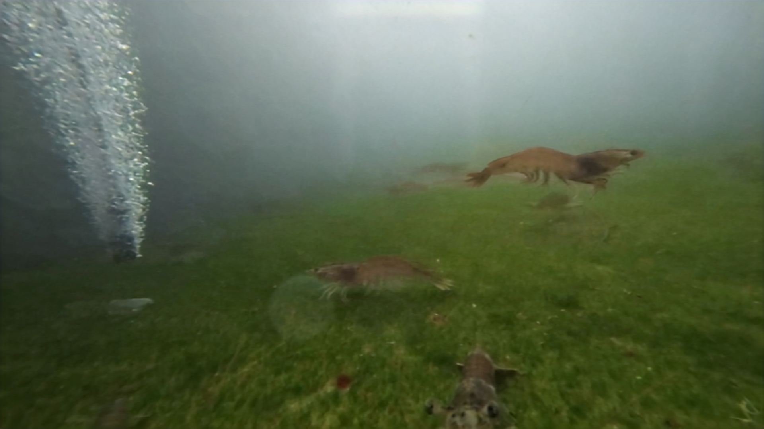
Inference

Slide 17
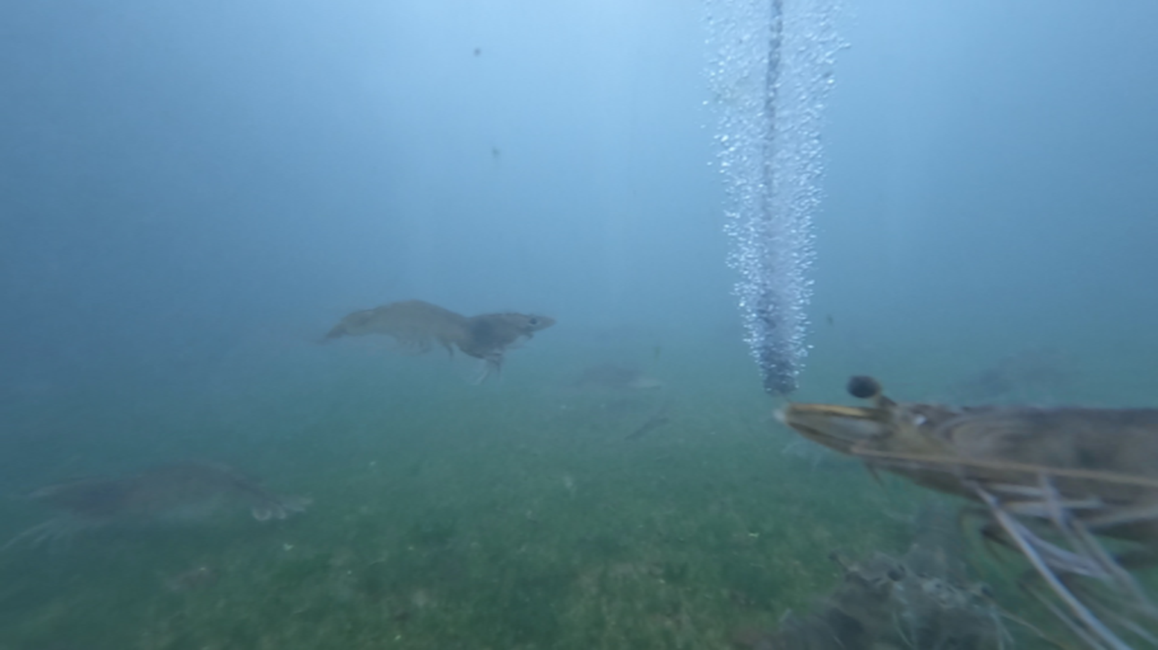
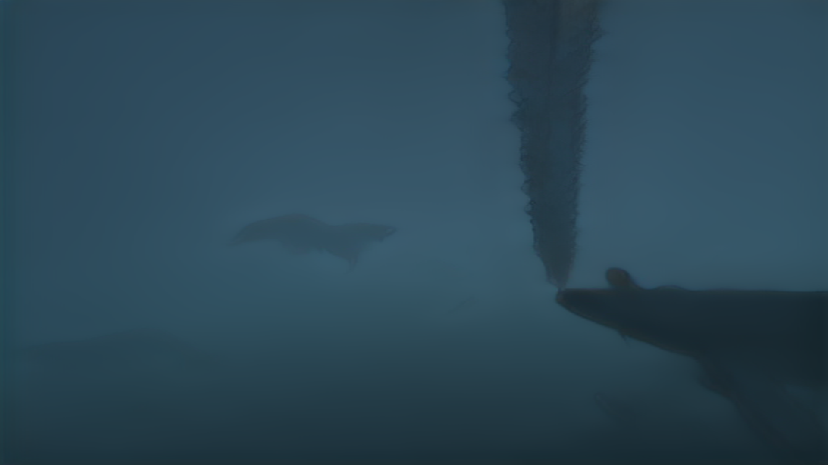
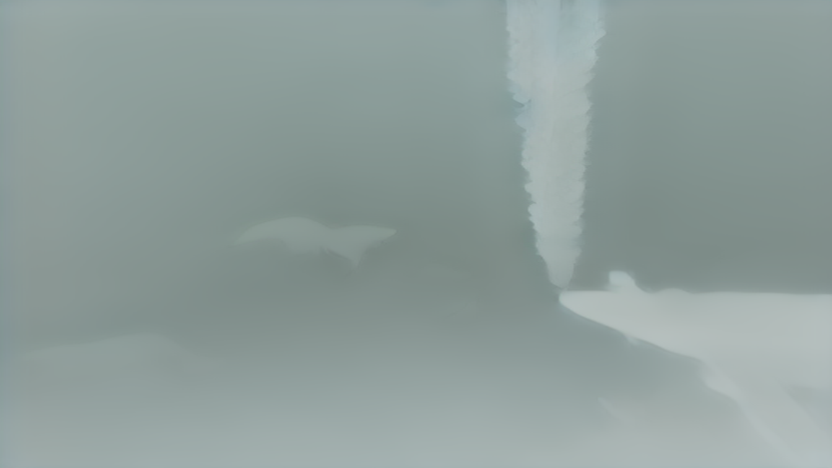
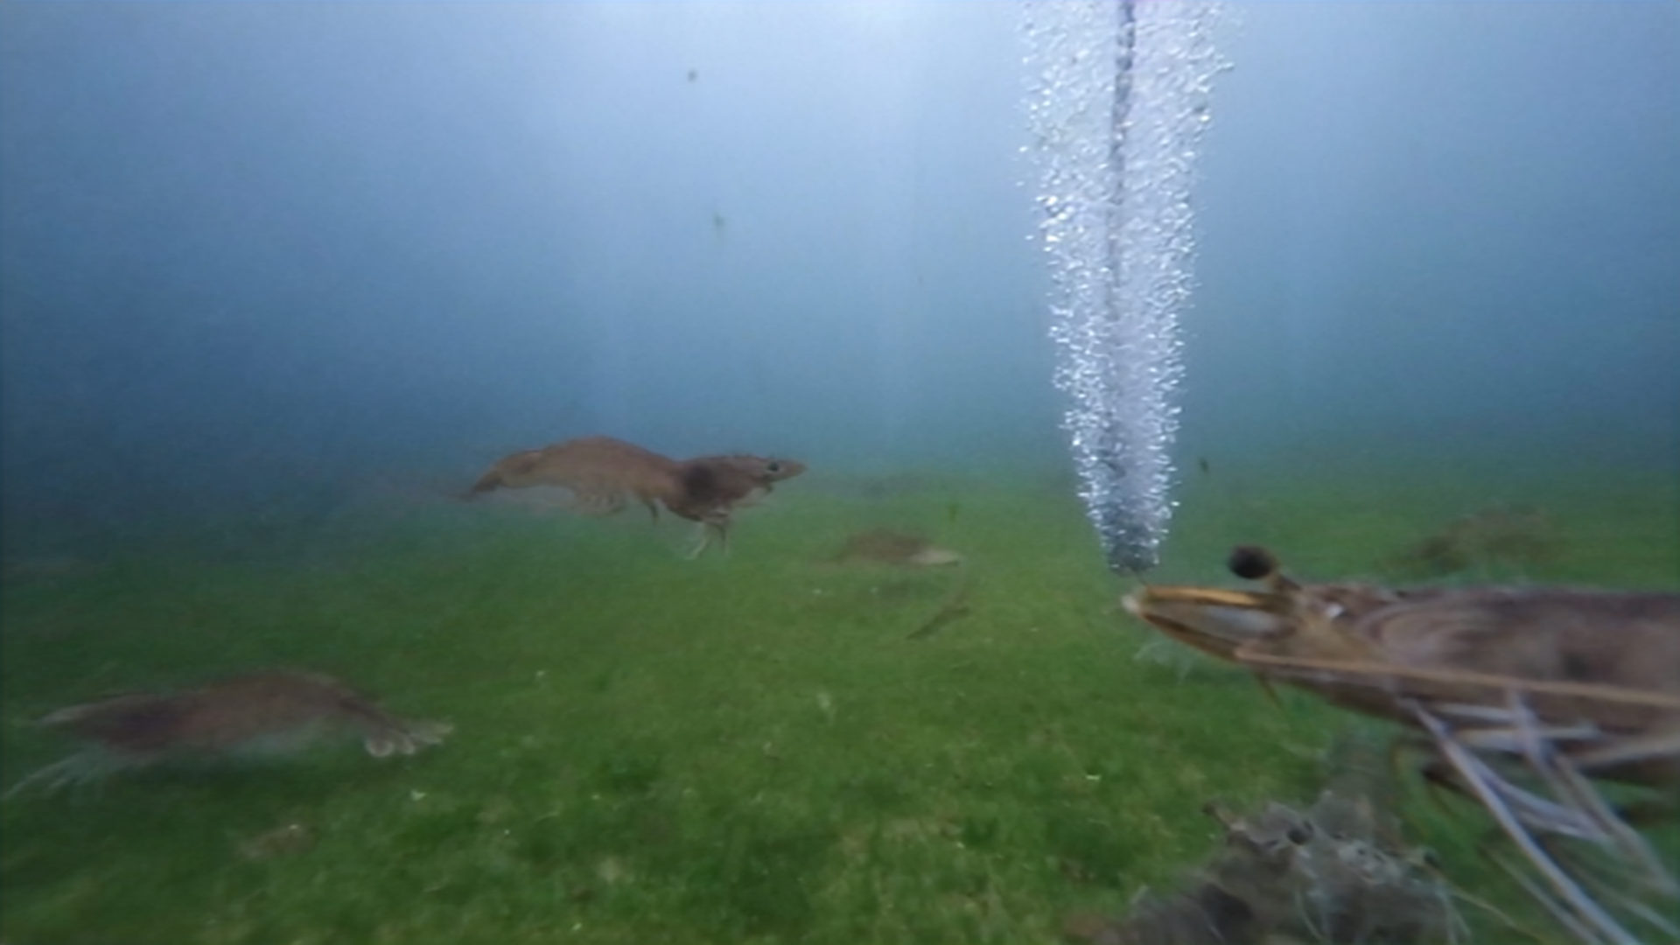
Inference

Slide 18
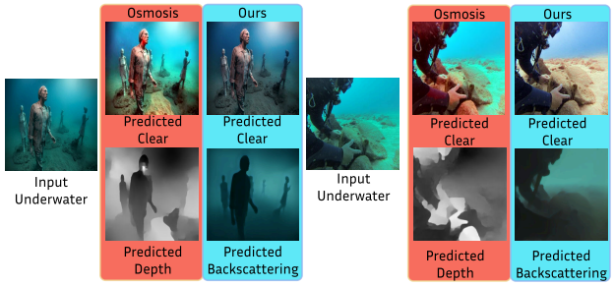
Inference

Slide 19
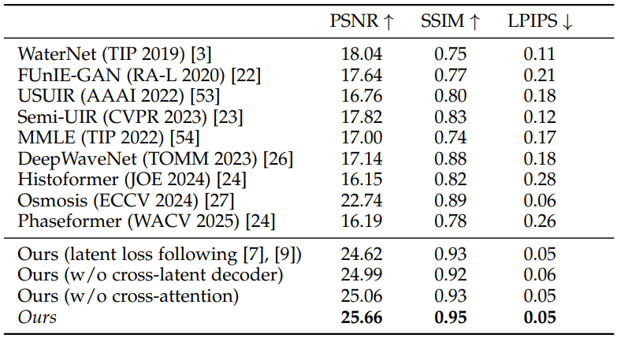
Quantitative Benchmarks

Slide 20
Qualitative Results: Physical Consistency
Disentanglement: SLURPP achieves a more distinct separation between the underlying scene content and the water medium.
Color Accuracy: Recovers more faithful color profiles and avoid artifacts.
Medium Prediction: SLURPP achieves superior accuracy in predicting Transmission (T) and Backscattering (B) compared to previous diffusion methods.

Slide 21
Conclusion and Future Work
SLURPP introduces a novel, fast, and single-step latent diffusion framework for underwater image restoration, effectively leveraging foundational visual and geometric priors to jointly predict the clear scene and water medium parameters.
Requires a consumer-grade GPU and is not yet real-time.
As a single-image method, it does not enforce temporal consistency, which may result in flickering artifacts when applied to video sequence.

